Slide 1
CALL Scotland: 2 October 2024
Welcome
Introductions
Training session content:
Background to resources
The Resources
Q&A following presentation

Slide 2
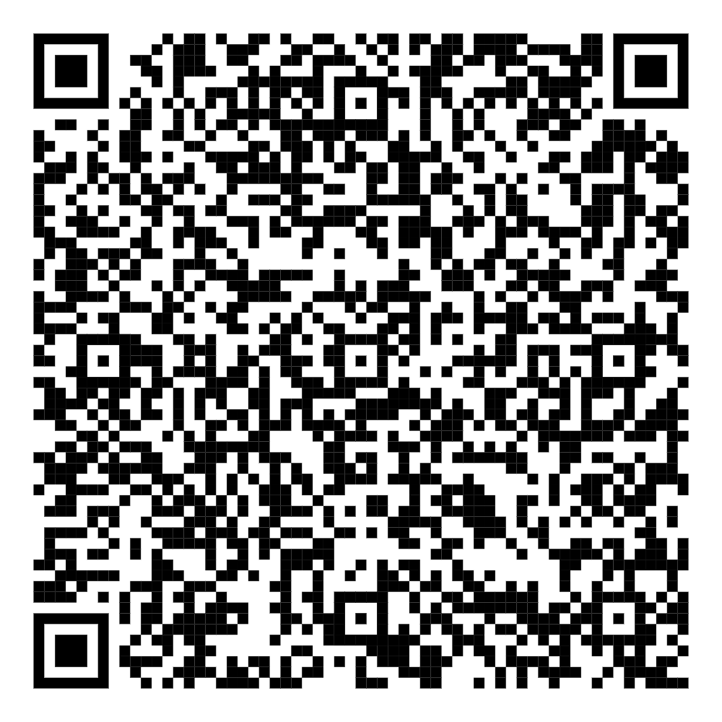
The Toy Box Diversity Lab: Disability Literacy through Imagination and Play
Slide Deck: https://www.dropbox.com/scl/fi/hvrzfgn6keykz31u7fgyu/CALL-Scotland-02_10_24.pptx?rlkey=f7rzx5h68e5svikgh0eimgkcd&st=gvdga6vh&dl=0
Dr. Siân Jones, Senior Lecturer in Education, CPsychol
Dr. Clare Uytman, Senior Lecturer in Psychology, CPsychol

Slide 3
01.
Disability Literacy, Representation, Inclusion, and Education.
Notes:
CU

Slide 4
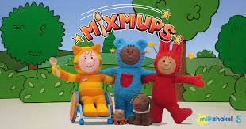
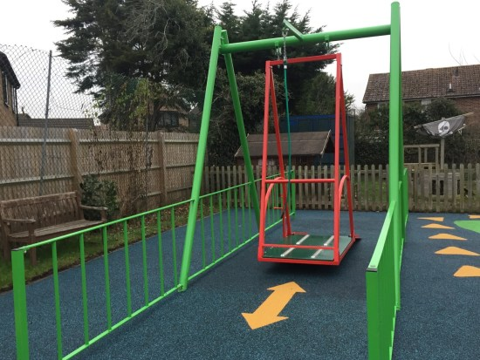
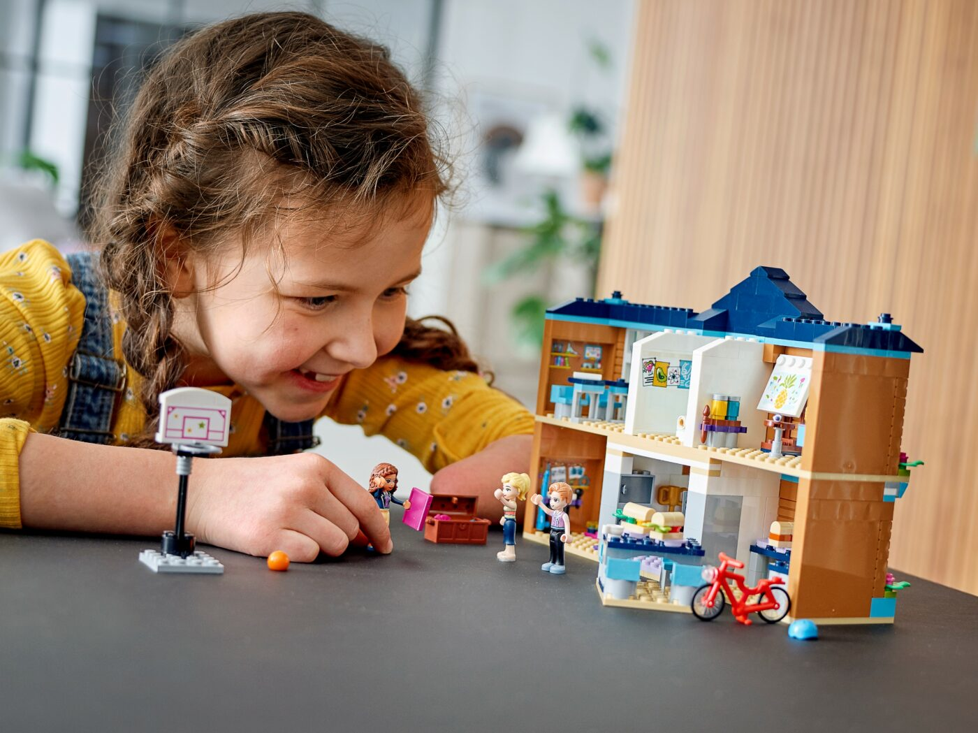
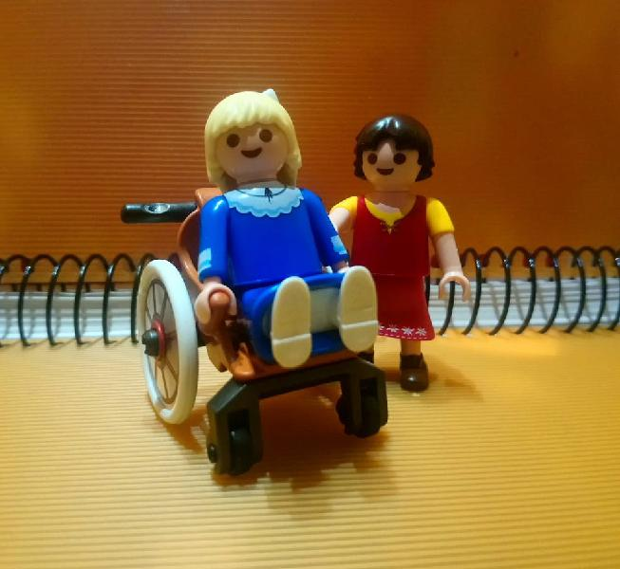
How are we framing disability?
Equality Act (2010) definition: ‘have a physical or mental health condition or illness that has lasted or is expected to last 12 months or more’, and ‘whether the condition and/or illness reduces their ability to carry out day-to-day activities’
In 2021/22, circa 11% of UK children were disabled (DfWP, 2023)
Medical Model:
Disability is impairment
1970s ff : Social and Affirmative models
Notes:
CU

Slide 5
Hate Crime & Dis/ableism
Bias-based discrimination towards disabled people is globally prevalent.
In Scotland, 592 disability hate crime reports in Scotland in 2022/23, rising from 550 in 2021/22 (+7.6%).
https://www.bbc.co.uk/sport/disability-sport/50692077

Slide 6
Disability (not explicitly) on the curriculum
Scottish Curriculum for Excellence (2010)
“I recognise that each individual has a unique blend of abilities and needs. I contribute to making my school community one which values individuals equally and is a welcoming place for all. HWB 1-10a.
England Primary Curriculum (2015)
Key Stage 2 ‘Citizenship/ PSHE’: “developing good relationships and respecting those with differences” (Department for Education, 2015).
Northern Ireland Primary Curriculum (2007)
Key Stage 2 “understanding that differences and similarities between people arise from a number of factors including cultural, ethnic/racial and religious diversity, gender and disability”
Key Stage 1: “appreciating ways we are similar and different, for example, age, culture, disability, gender, hobbies, race, religion, sporting interests, abilities and work”
Curriculum for Wales (2022):
“As learners progress, they should become increasingly aware of a range of specific characteristics which can define our identity, including sex, gender, race, religion, age, disability and sexuality…. Practitioners should also tell and listen to the stories of different groups, including minority groups, and enable all learners to see themselves and their experiences represented in the topics, experiences and knowledge developed through the curriculum”.
But not in any of the five levels’ ‘descriptions for learning’
This Photo by Unknow Author is licensed under CC BY-SA

Slide 7
Mirrors and Windows
Favazza and colleagues (1999, 2017, 2023)
Looked at the proportional representation of disabled people in school resources in 32 infant classrooms.
They found that two classrooms had some representation, 22 classrooms had low representation, and eight classrooms had no representation of disabled people.
CIRCLE Framework focuses on participation rather than representation.
Image generated through AI: A UK infant school corridor
Notes:
SJ

Slide 8
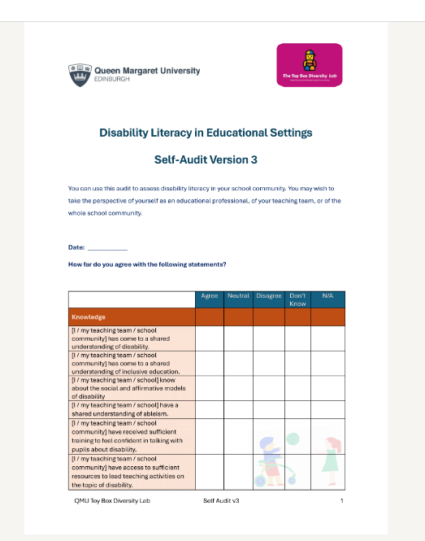
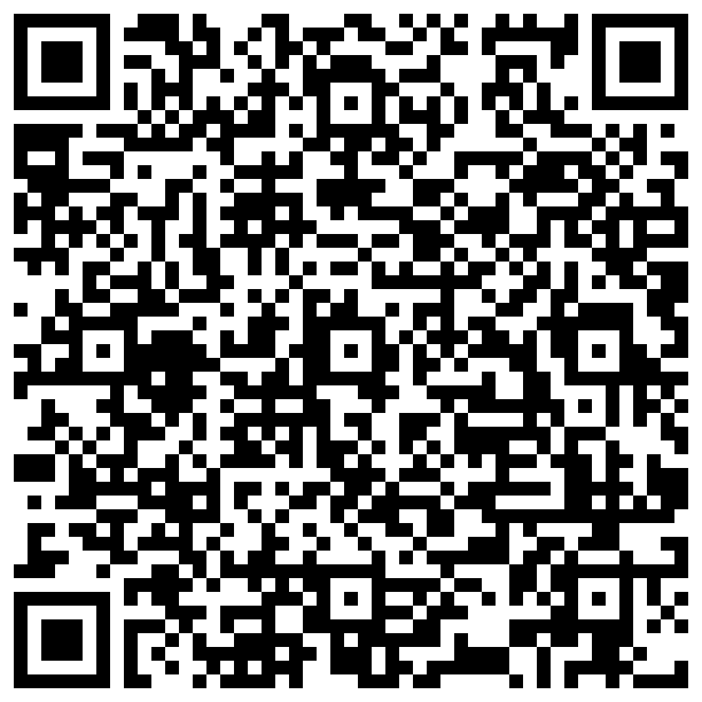
Self-Audit
https://www.dropbox.com/scl/fi/7mucjkej1juvd8ifrt1bf/Disability-Literacy-in-Educational-Settings-Self-Audit_V3.docx?rlkey=j07xs6wuknxi96tbvhf45csbq&st=27sx7mz6&dl=0

Slide 9
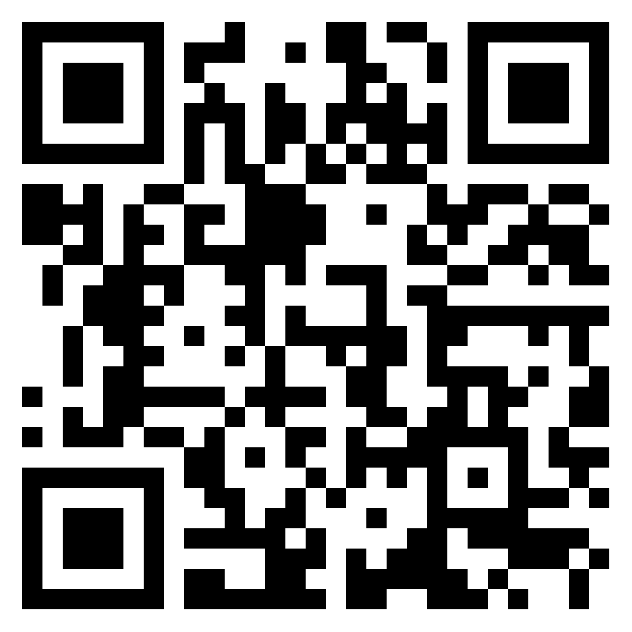
Discussion point: How easy is it for children to see disabled people represented in your professional environment? Connect to PADLET here

Slide 10
Silence is unhelpful...
“Do you know what they call kids like us, in England?” she asks me.
“I can imagine”, I say, “but tell me.”
“SEND”
“SEND?”
“Yeah”
“Is it short for something?”
“No, it’s special educational needs and disabilities”.
“Why can’t they just say disabled?”
" Maybe it's because they want to send us away' Bonnie finally says quietly."
This Photo by Unknown Author is licensed under CC BY

Slide 11
National Framework for Inclusion links
How do I ensure that I include all the learners I teach? How does this influence how and what I teach?
What biases may I have? In what ways might these impact on my practice, and how might I challenge these?
How do policies, structures, practices and spaces promote or inhibit inequalities which impact on sense of belonging in the learning community?
How can I extend opportunities for participation, collaboration and learning together, which promote equality, diversity and belonging in my classroom?
In Scotland Education is guided by the National Framework for Inclusion
This broader view invites consideration of what it means to educate all children together.
Broad research agenda looking at the role of education in breaking down barriers and reducing prejudice towards disabled people.
School based interventions are an ideal opportunity to tackle prejudicial attitudes towards disability and foster positive relationships.
https://www.gtcs.org.uk/professional-standards/national-framework-for-inclusion/

Slide 12
Inclusion Wellbeing Equality Professional Learning links
These resources are ideally placed within this framework, to support educators with incorporating these four-cornerstones of inclusion, well-being and equality into their practice.
These resources provide not only an updated understanding of disability models, but also give educators the confidence to talk about disability and consider the importance of representation in affecting change in experience and attitudes.

Slide 13
Key Point
The resources are mapped to the CfE and can be embedded into existing Experiences and Outcomes planning / benchmarking without extra work from educators.

Slide 14
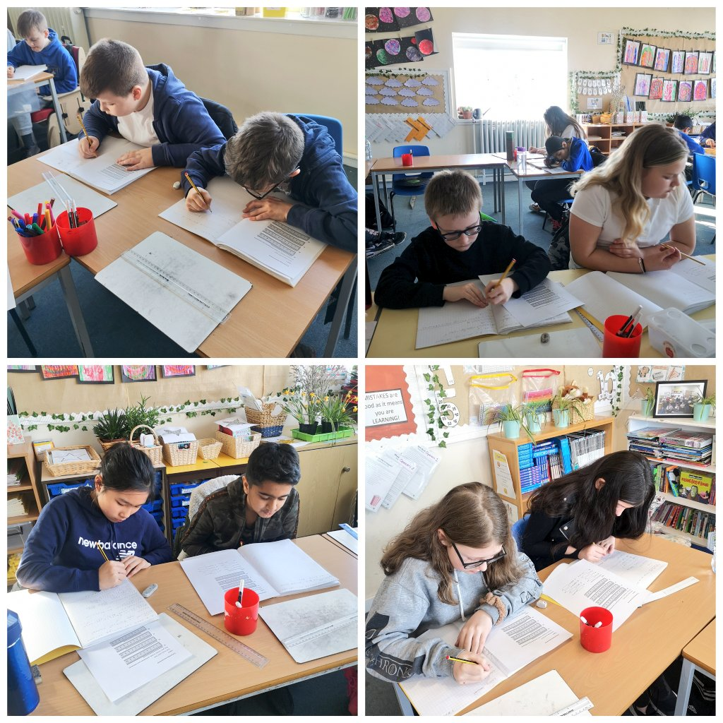
@QMUToyResearch
02. Resources
Notes:
CU

Slide 15
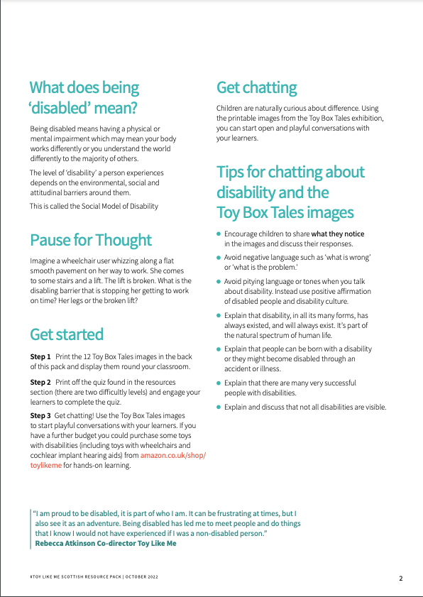
Using the ToyBox Tales Resources You can access the PDF of the pack directly via our website here: https://qmutoyboxdiversitylab.com
Notes:
As on slide

Slide 16
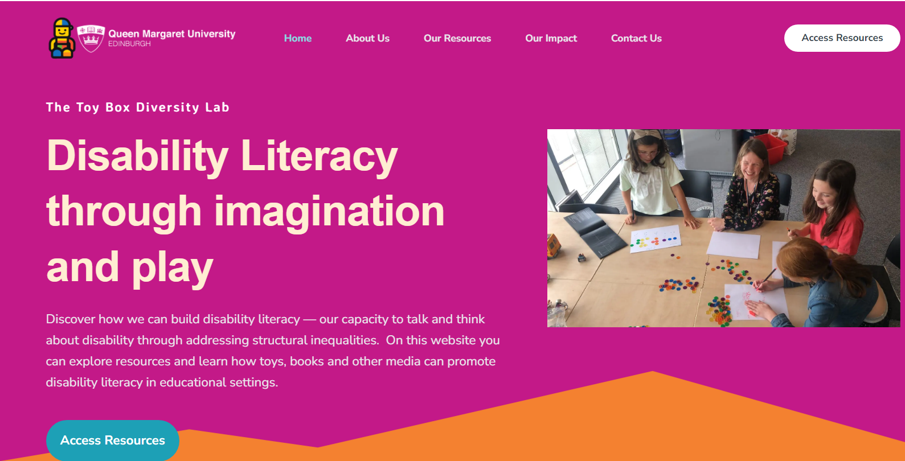
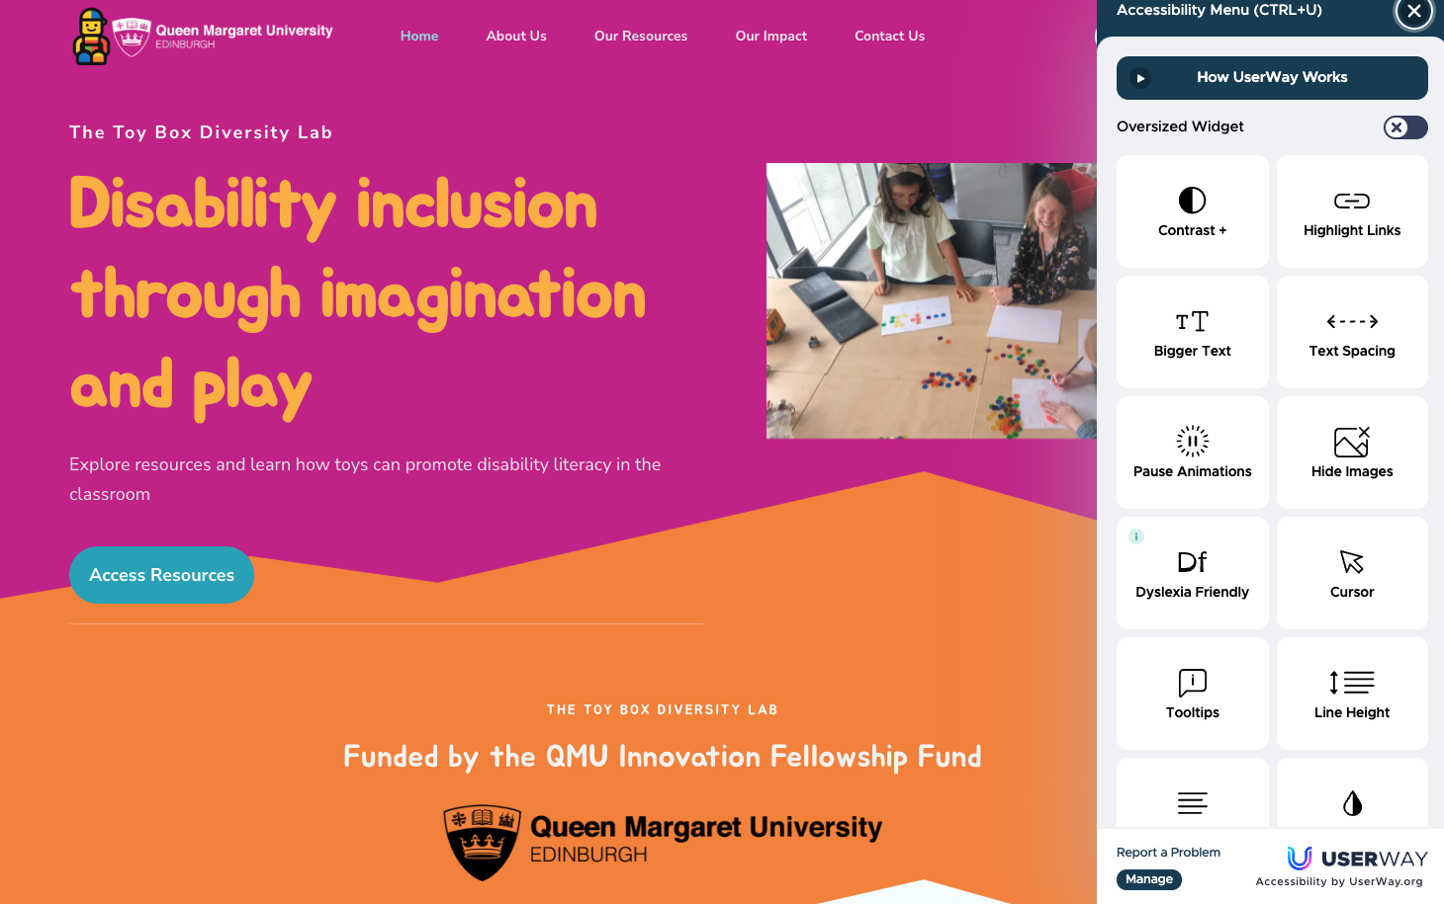
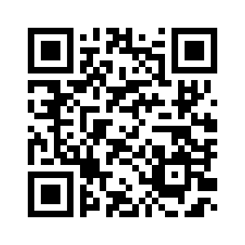
Our home page:
www.qmutoyboxdiversitylab.com
About Us
Our Resources
Our Impact
Contact Us.
Access Resources
www.qmutoyboxdiversitylab.com
Notes:
CU

Slide 17
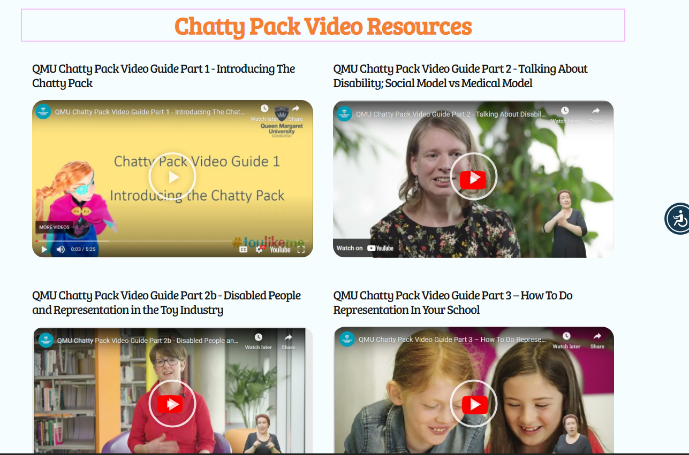
Video resources
Five short videos exploring theory and research, the social and medical models of disability, representation and how to enhance representation in your school
Notes:
CU

Slide 18
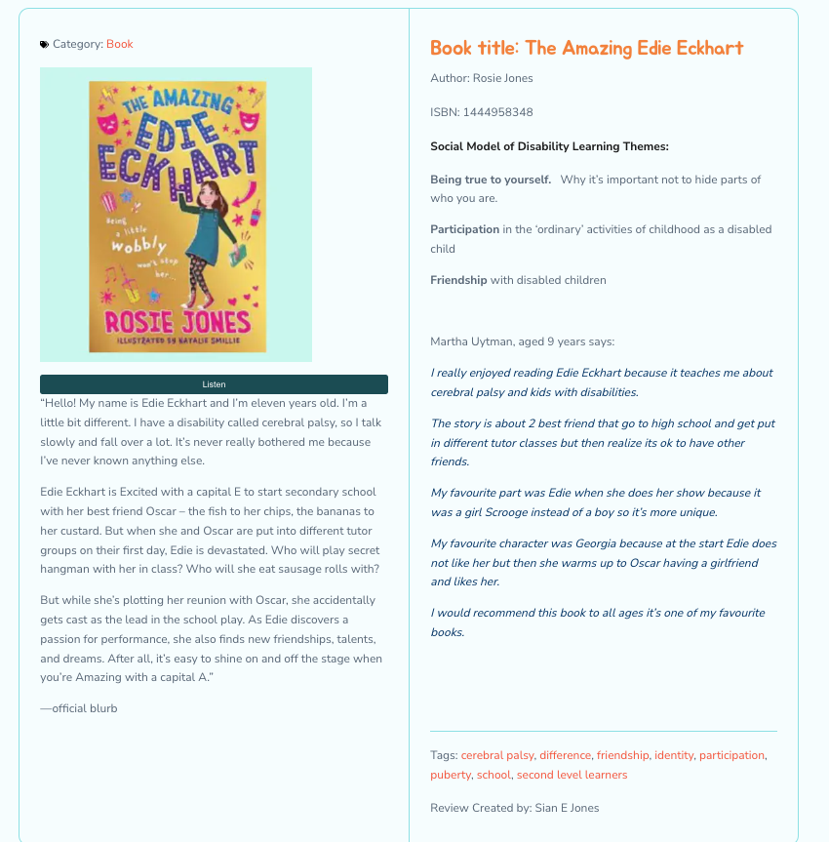
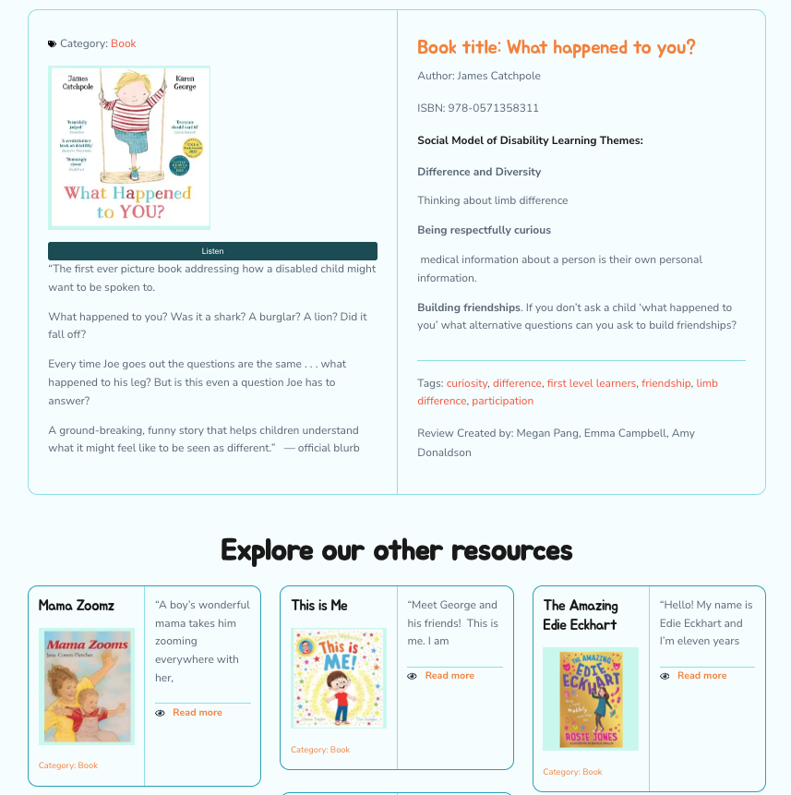
Notes:
CU

Slide 19
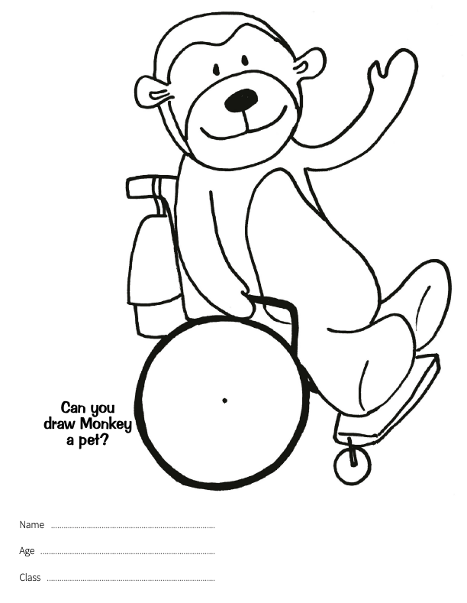
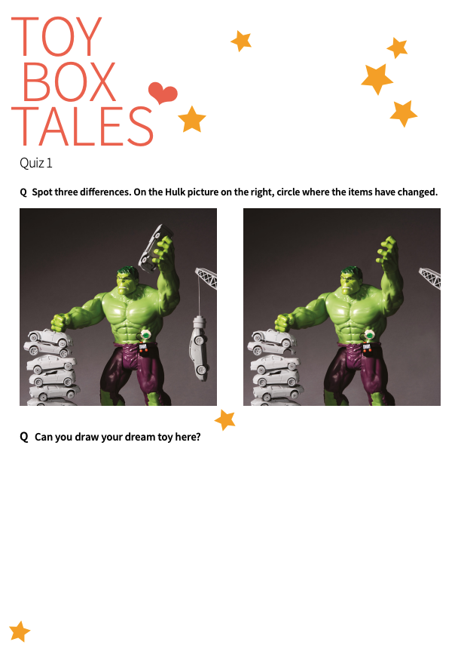
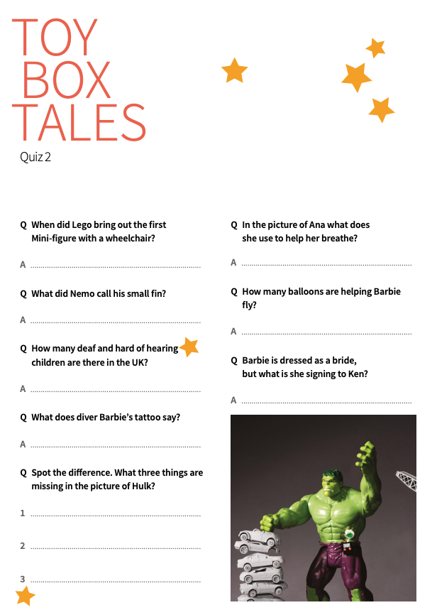
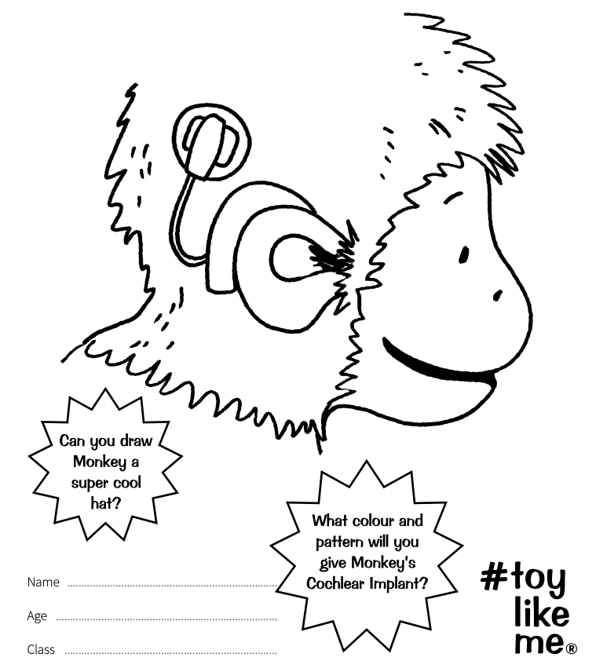
Quizzes and Activity Sheets
Notes:
As on slide

Slide 20
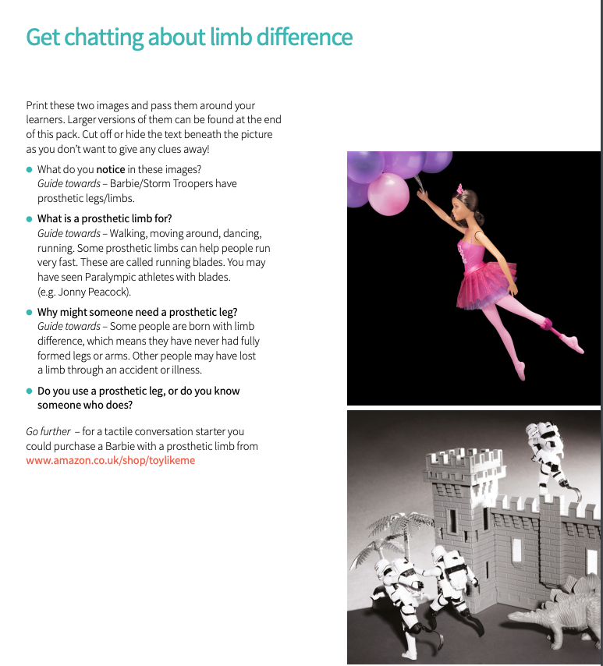
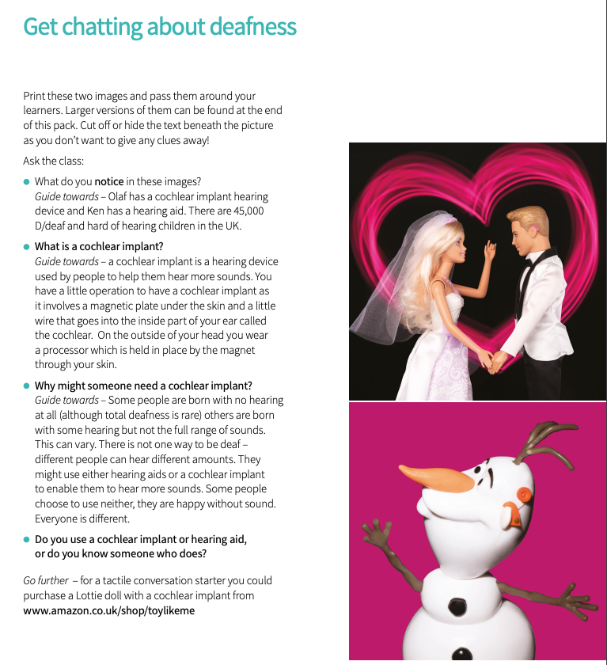
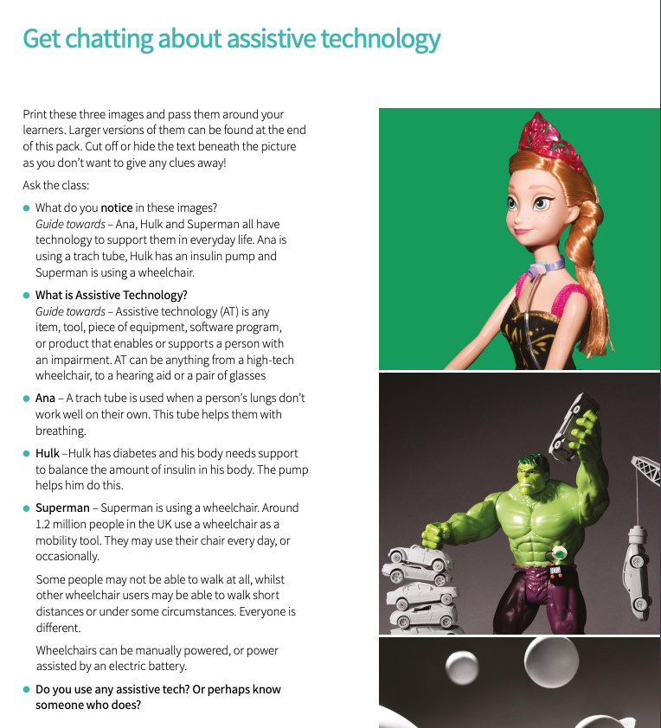
Exhibition Images and Get Chatting Guidance
Notes:
As on slide

Slide 21
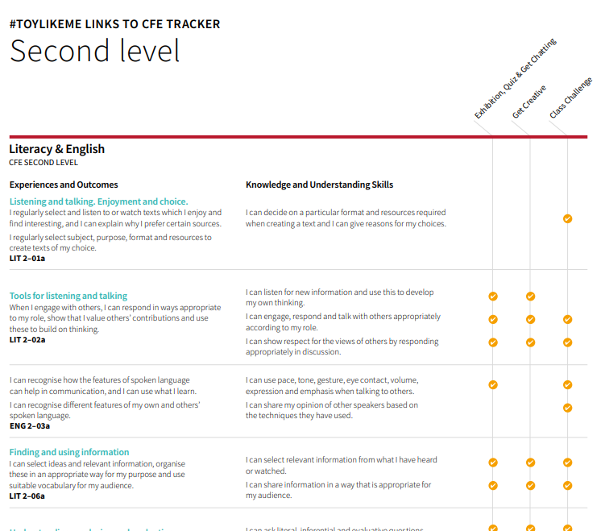
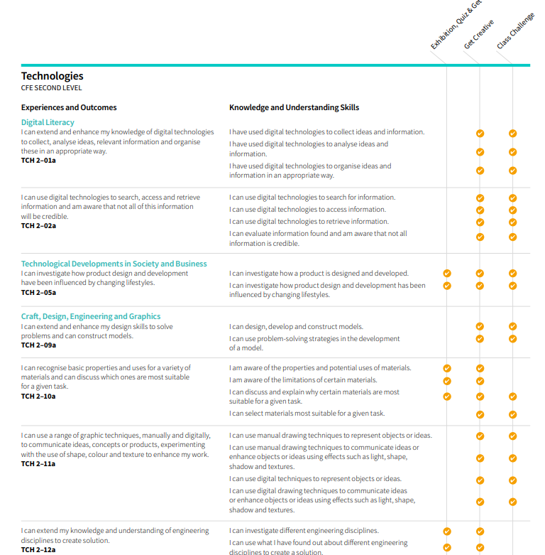
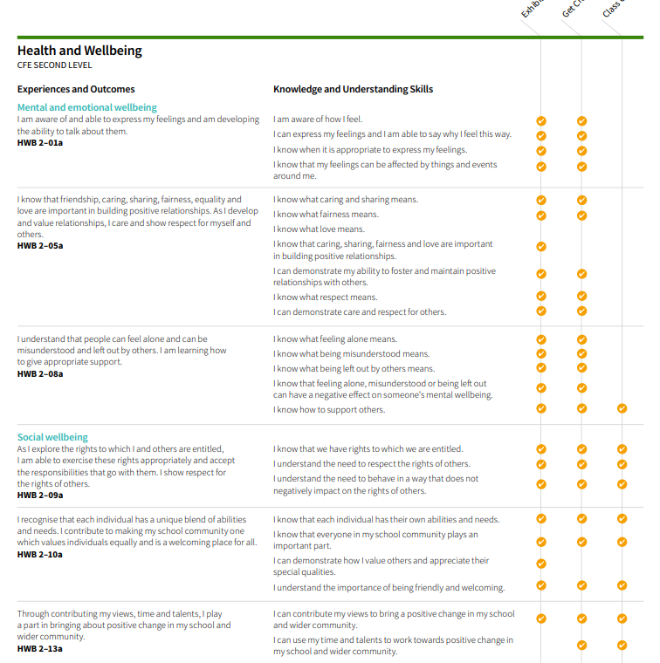
Mapping to the Curriculum for Excellence
Notes:
Originally mapped to the English, not the Scottish...
We're not adapted this
We have mapped the chatty pack to the areas of the cfe at first and second level.
We've got another application to extend this project, beyond the chatty pack to a whole suite of resources which will be co-created...

Slide 22
Resources in Practice
Study assessed the effectiveness of a short (90-minute) training session and engaging with a disability resource pack (The Big Chatty Pack) on educators’ knowledge, confidence and skills in teaching their learners about disability.
Mixed methods approach of N = 6 teachers and their (N = circa 150) learners.
Promising results suggest easy-to-implement changes to the general education classroom
Salminen, L., Uytman, C., & Jones, S.E. (2024) .”Gave me confidence as a teacher to approach the subject”: Assessing the Chatty Pack: the impact of engaging with disability representation resources on educators’ knowledge, experience and skills in teaching their learners about disability. Masters Thesis, Queen Margaret University.

Slide 23
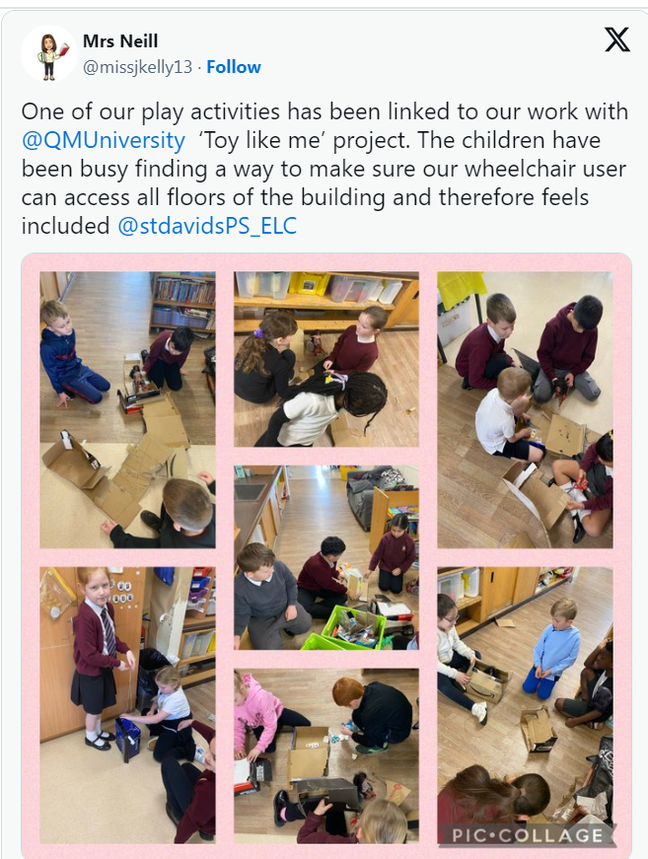
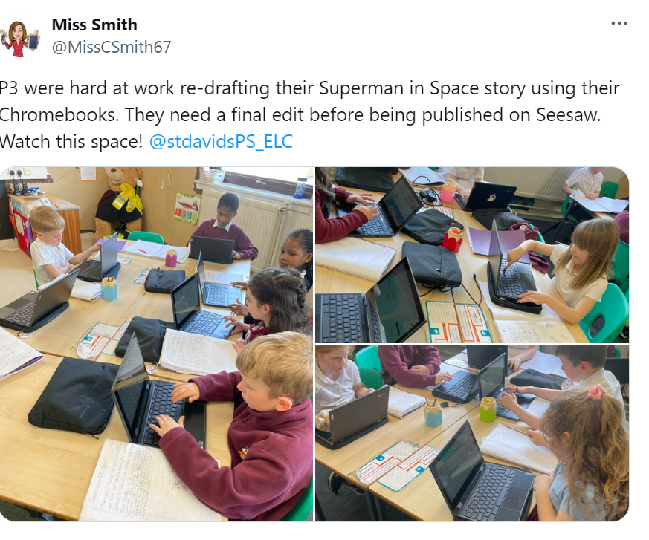
Resources in Practice

Slide 24
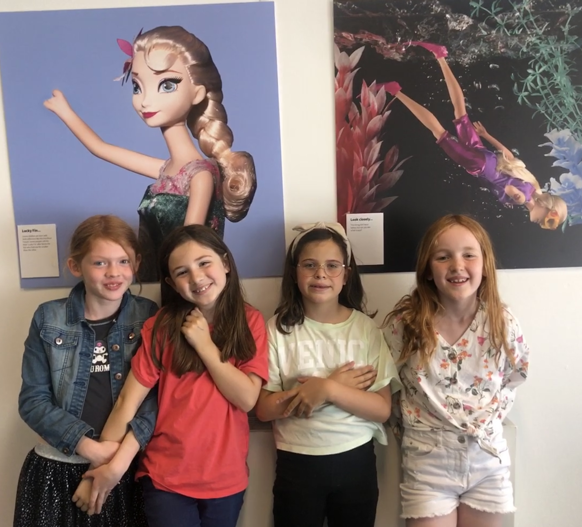
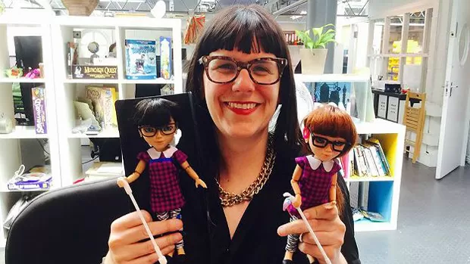
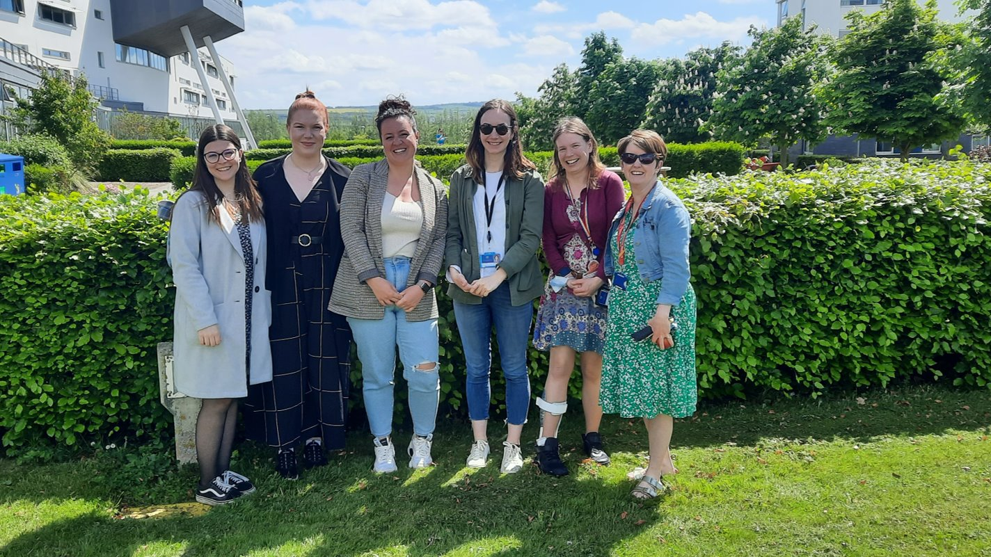
Thank you for your participation
https://qmutoyboxdiversitylab.com/
With thanks to
the QMU Innovation Fund
Laura Salminen and Catriona Rennie.
Rebecca Atkinson and Karen Newell at ToyLikeMe, https://www.toylikeme.org/
the students of our ToyBox Research Group
Michael Grant @ Raw Films
and to our fantastic participants and video stars
ToyBoxResearchGroup@qmu.ac.uk
@QMUToyresearch
Notes:
As on slide

Slide 25
Feedback This also gives you a link to sign up to our Disability Literacy in Educational Settings Network
https://app.onlinesurveys.jisc.ac.uk/s/qmu/call-disability-literacy-through-imagination-and-play-webinar

Slide 26
Support and signposting
ToyLikeMe: https://www.toylikeme.org/
The LUNA Project: https://www.thelunaproject.org.uk/
I Am Me Scotland: https://iammescotland.co.uk/
Scope: https://www.scope.org.uk/advice-and-support/disability-discrimination-at-work/
Glasgow Disability Alliance: https://gda.scot/
The Alliance: https://www.alliance-scotland.org.uk/about-the-alliance/
Inclusion Scotland: https://inclusionscotland.org/
Scottish Independent Advocacy Alliance: https://www.siaa.org.uk/

